Slide 1









Smart Mobility@Chula
Mr. Soe Ye Htet
Chulalongkorn University, Thailand

Slide 2
Contents
Introduction
Traffic Congestion in Bangkok
Background
Traditional Networking Vs Software-Defined Networking
Wireless Mesh Network (WMN)
Software-Defined Wireless Mesh Network (SDWMN)
Implementation of Outdoor SDWMN Testbed With Fault -Tolerant Multi-hop Routing on unreachable of Wireless Mesh Node
Hardware List
Applied Software Tools
Setting of Actual Testbed Component Installation
Practical Deployment Trial for Integrated SDWMN and Traffic Monitoring Application on Phaya Thai Road
Temperature Measurement of Wireless Mesh Node During Outdoor Network Operation
Forwarding Procedure of Wireless Mesh Node
Practical Deployment Trial for Integrated SDWMN and Traffic Monitoring Application on Phaya Thai Road
Design of Updated SDWMN with Virtual Private Network

Slide 3

Introduction
Traffic Congestion in Bangkok
Become major problem for people daily life.
Source : Google Image

Slide 4
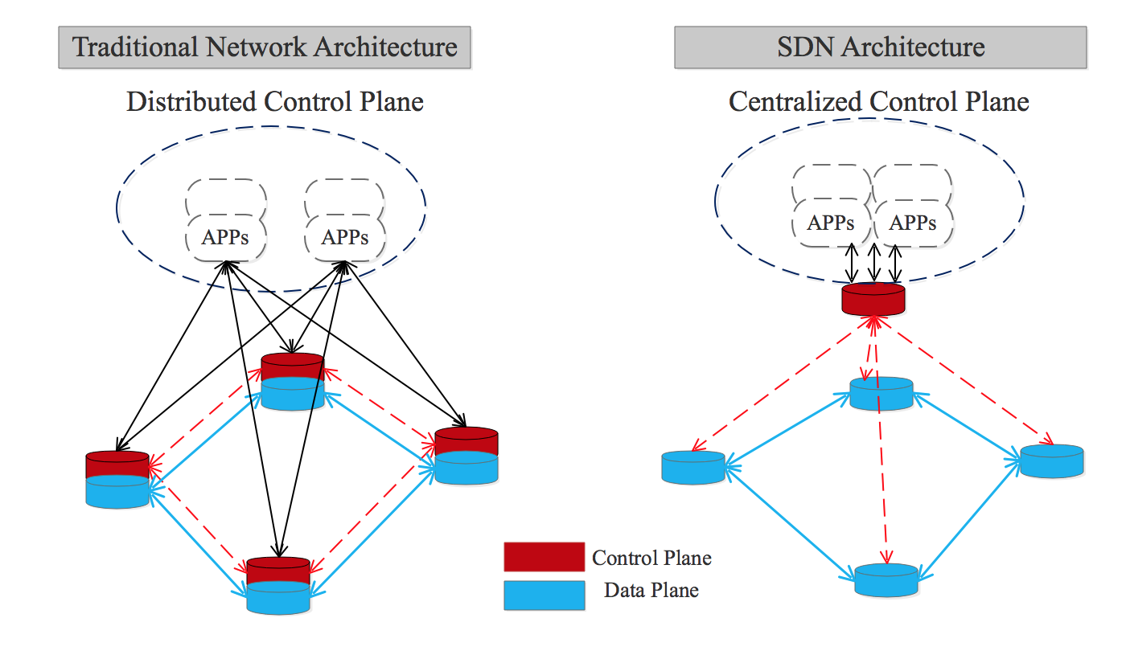
https://blogs.cisco.com/ciscoit/sdn-101-what-it-is-why-it-matters-and-how-to-do-it [ December , 2019]
Background
Traditional Network Vs SDN Network

Slide 5
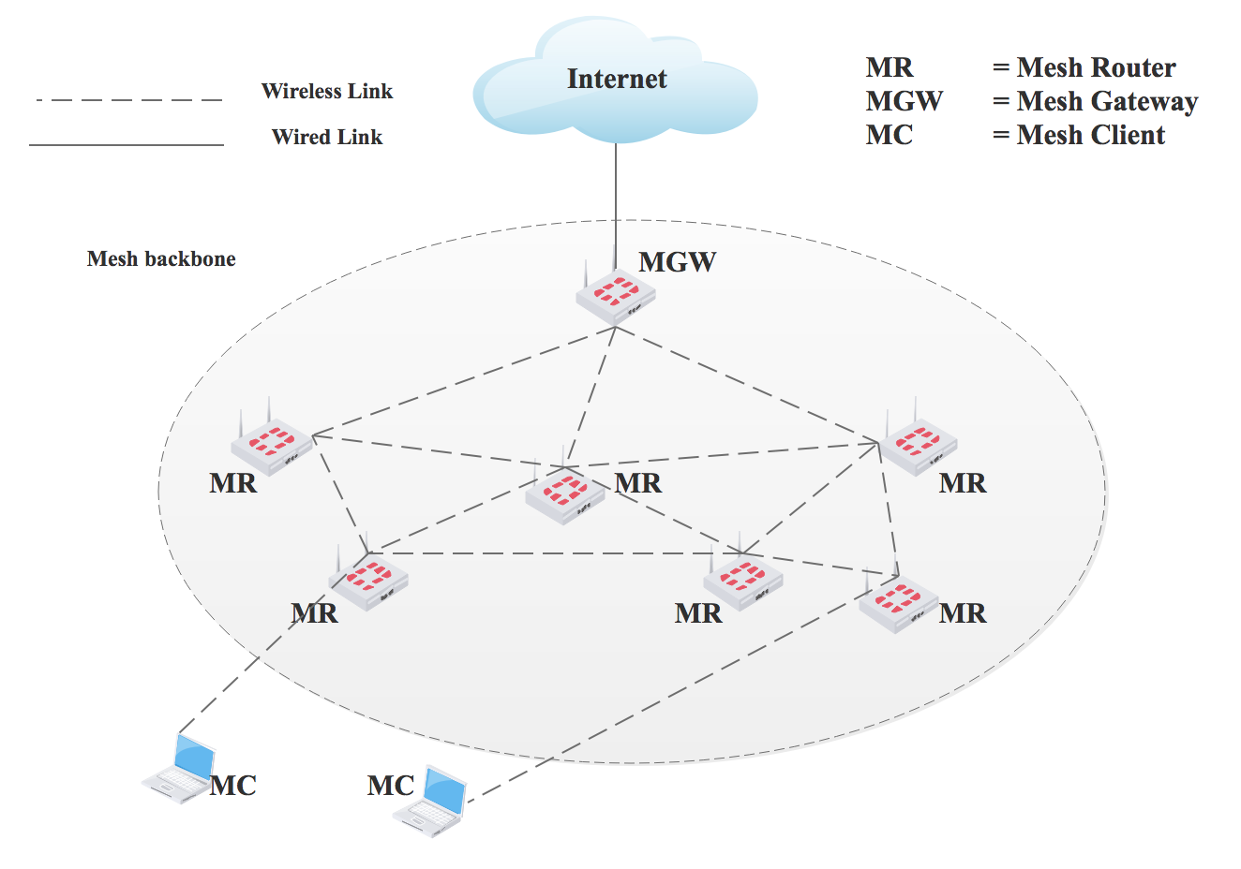
Wireless Mesh Network (WMN)
Distributed
No centralized point
Difficult to be managed and modified
M. Seyedzadegan, M. Othman, B. M. Ali and S. Subramaniam, ``Wireless mesh networks: WMN overview, WMN architecture.,'' International Conference on Communication Engineering and Networks IPCSIT, Vol. 19, pp. 12-18, 2011.
Notes:
Traditional wireless mesh networks with a distributed routing protocol is generally difficult to manage. This is because of the complex structure of wireless mesh topology and hence a manual configuration often required upon significant network routing upgrades.

Slide 6
Software Defined Networking (SDN)
Routing, Load Balancing
Application Plane
SDN Application
SDN Application
Northbound
Interface
API
API
Control Plane
SDN Controller
Southbound
Interface
Control Data Plane Interface
(eg. OpenFlow)
Data Plane
Routers
Routers
Routers
Network Devices
[2] Open Network Foundation,“Software Defined Networking: The new norm for networks,” ONF White Paper, 2012

Slide 7
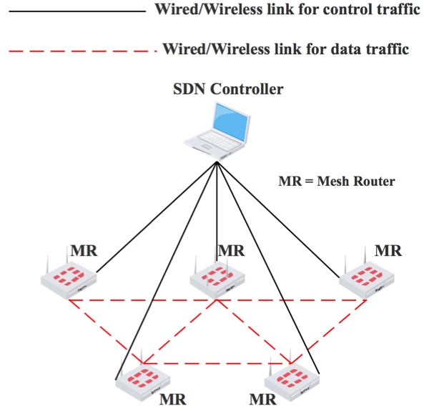
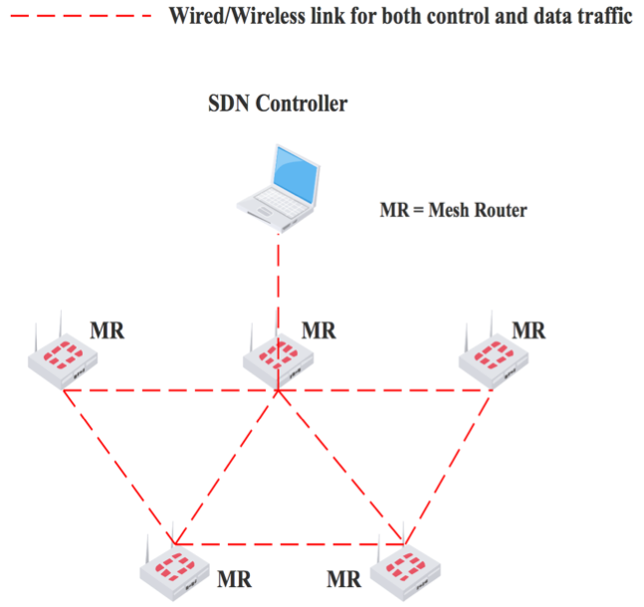
Out-of-band vs In-band
Two separate network for control and data
Same network for control and data
Out-of-band
In-band
M. Antikainen, T. Aura and M. S ̈arel ̈a, “Spook in your network: Attacking an SDN with a compromised OpenFlow switch,” Nordic Conference on Secure IT Systems, pp. 229-244, 2014.

Slide 8
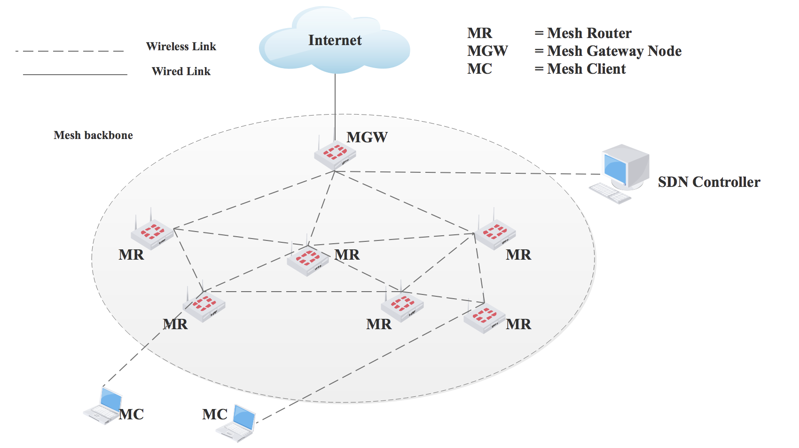
Software-Defined Wireless Mesh Network (SDWMN)
Centralized
Easy to be managed and modified.
Notes:
Researchers have proposed to use the feature of software defined networking (SDN) with inherently enhanced network programmability. Here, the control plane and data plane are separated by using the standard OpenFlow protocol. Advantageously, the centralized SDN controller receiving all necessary signaling via the control plane would have the global view of wireless mesh network status. An enhancement can thus be expected by SDN.

Slide 9
WMN vs SDWMN
 | Network Type | OpenFlow | Manageability
Conventional WMN | Distributed | No | Difficult
SDWMN | Centralized | Yes | Easy

Slide 10
Implementation of Outdoor SDWMN Testbed With Fault-Tolerant Multi-hop Routing on unreachable of Wireless Mesh Node
Hardware Lists
Applied Software Tools
Setting of Actual Testbed Component Installation
Illustration of Routing on Primary Route for Control Plane in Proposed Outdoor Small-scale SDWMN Testbed
Illustration of Routing on Primary Route for Data Plane in Proposed Outdoor Small-scale SDWMN Testbed
Implementation of In-band Control Plane and Data Plane in Outdoor Medium-Range SDWMN Testbed
Detection of Liveness of Every Active/Inactive Wireless Mesh Node by Ryu Controller

Slide 11
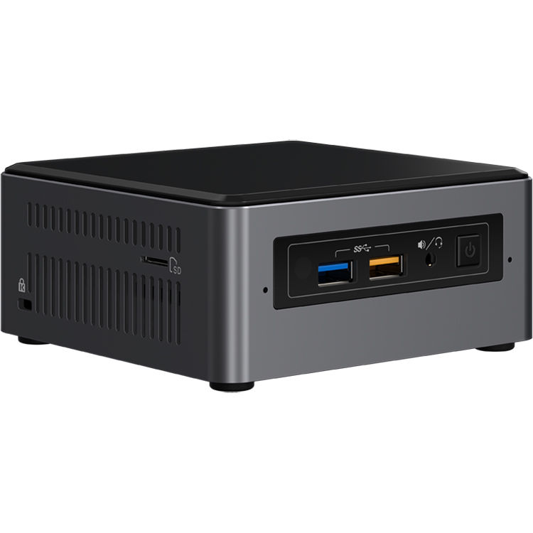
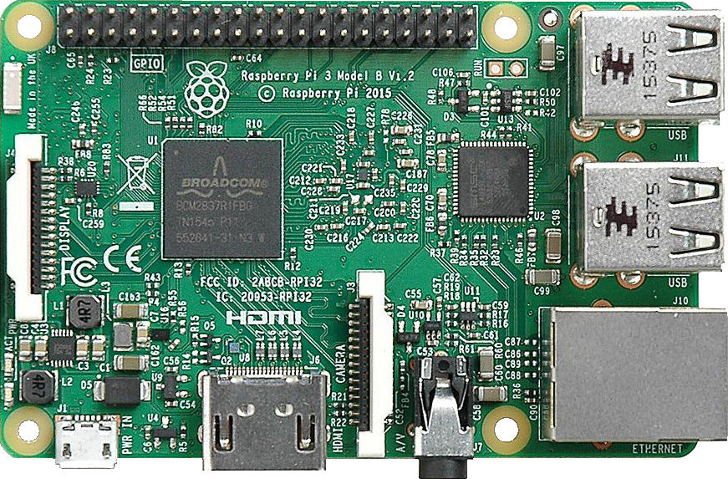
Hardware list
Intel ® NUC7i7BNH [12]
Specification
Intel ® CoreTM i7- 7567U
16 GB (RAM)
500 GB (HDD)
Gateway
Receive data from a wireless mesh node
[12] https://ark.intel.com/products/95065/Intel-NUC-Kit-NUC7i7BNH [June 7, 2018].
Raspberry Pi 3 [11]
Specification
Quad core 1.2 GHz
1 GB (RAM)
32 GB (SD Card)
Wireless Mesh Node
Send data
Relay data
[11] https://www.raspberrypi.org/products/raspberry-pi-3-model-b/

Slide 12
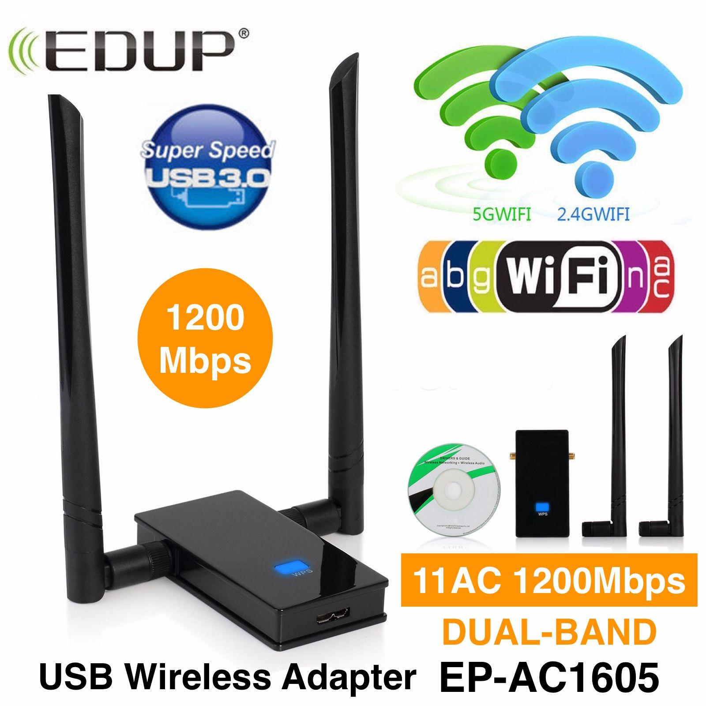

Hardware list
EDUP EP-AC1605 Dual-Band Antenna [22]
Specification
Dual-Band ( Support 2.4 GHz & 5 GHz )
2 x ( 6 dBi omnidirectional antenna )
Medium-range network reachability
[22] http://www.szedup.com/product-item/ac-1200mbps-wifi-usb-adapter/
Battery
Specification
20000 mAh
To provide the necessary power to the wireless mesh node
https://www.eloopthailand.com/collections/e14-20000-mah

Slide 13
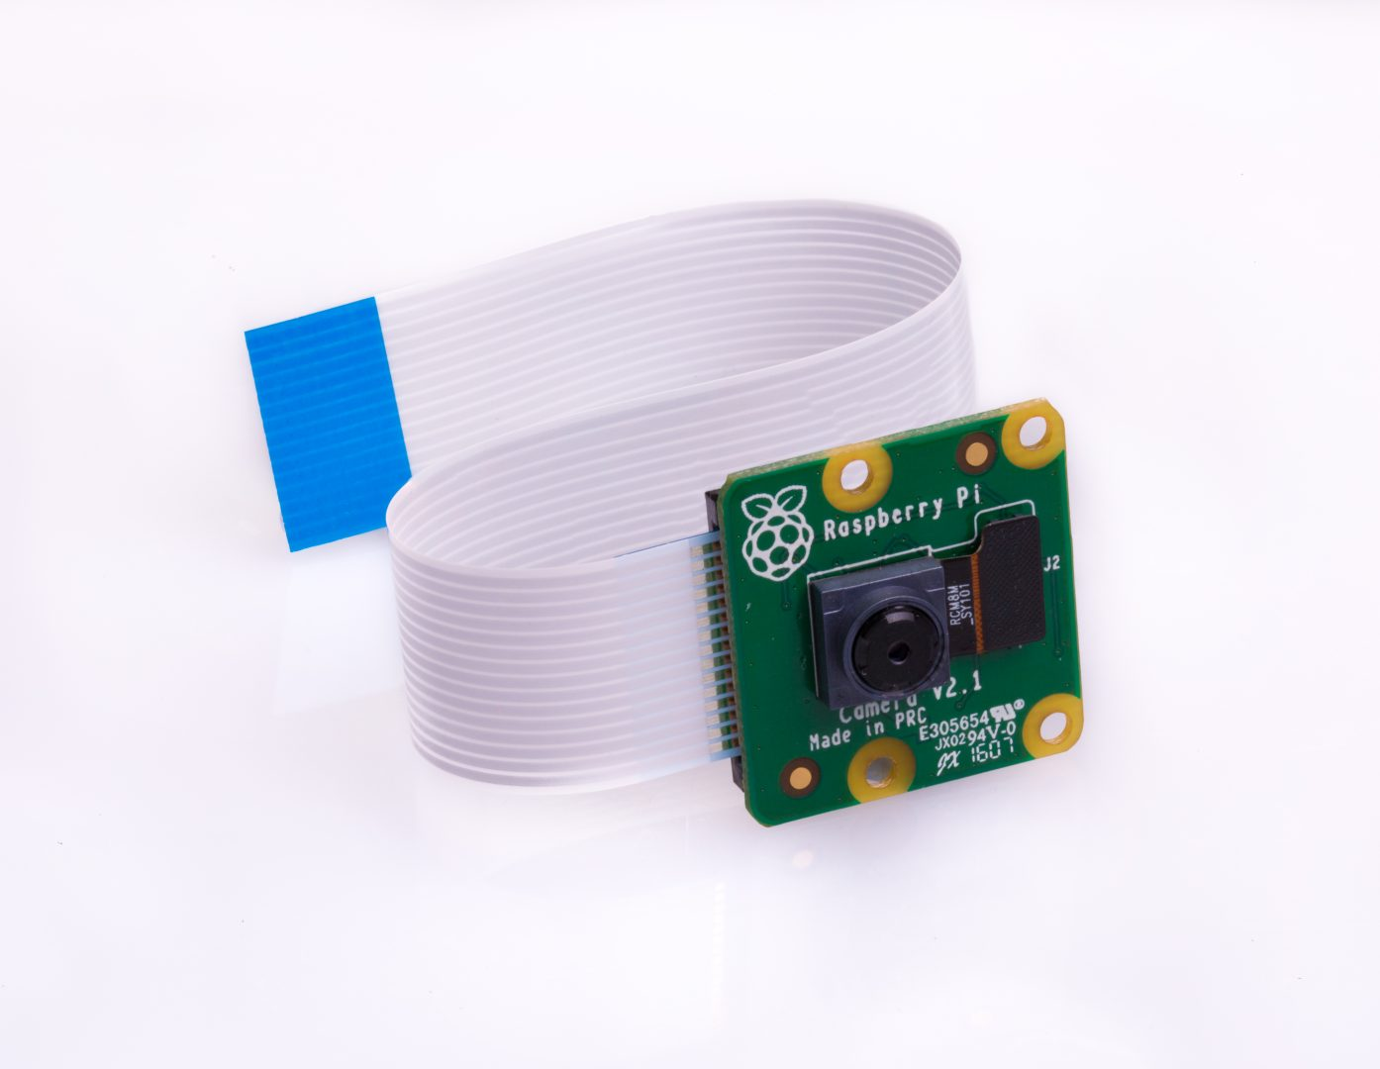
Hardware list
Raspberry Pi Camera Module V2
Specification
Sony IMX219 8-megapixel sensor
Support 1080p, 729p60 and VGA 90 video modes
To capture image or video
https://www.raspberrypi.org/products/camera-module-v2/
Notes:
720p60 – runs at 60 fps

Slide 14
Applied Software Tools
Software | Function | Installed Node
Open Vswitch (OVS) [5] | Virtual OpenFlow switch | gateway & wireless mesh node
RYU [17] | SDN controller platform | gateway
Ubuntu Mate (32 bit) [13] | Linux operating system | wireless mesh node
Iperf [19] | TCP/UDP throughput measurement tool | gateway & wireless mesh node
Ubuntu (32 bit) | Linux operating system | gateway
Open vSwitch [Online] – Available from: http://openvswitch.org/ [June 7, 2018].
Ubunut-Mate [Online]. Available from : https://ubuntu-mate.org/ [August 18, 2018].
RYU SDN Framework [Online] – Available from: https://osrg.github.io/ryu-book/en/Ryubook.pdf [June 7, 2018].
iPerf [Online]. Available from : https://iperf.fr/ [July 13, 2018]

Slide 15
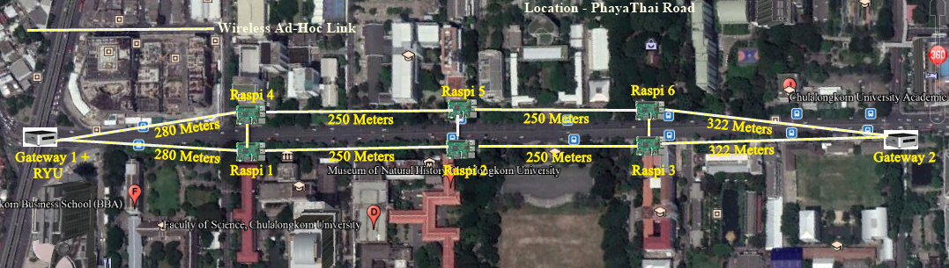
Setting of Actual Testbed Component Installation
Topology of real outdoor SDWMN testbed on Phaya Thai road for road traﬃc monitoring network

Slide 16
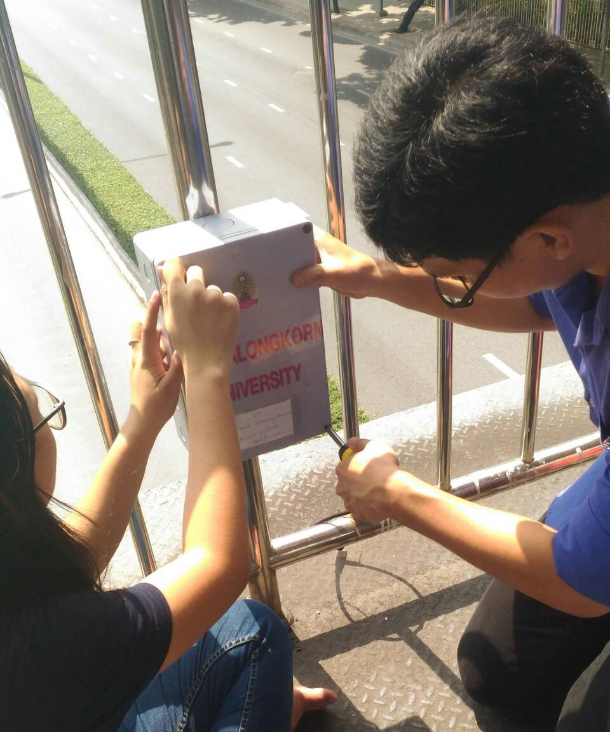
Installation of waterproof box at fence of crossover bridge on Phaya Thai Road

Slide 17
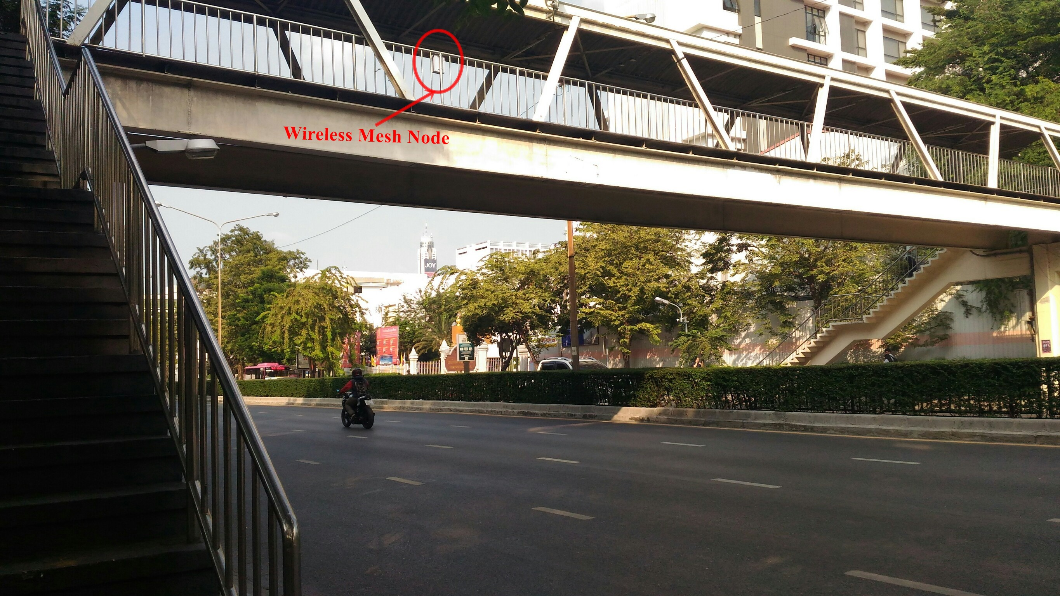
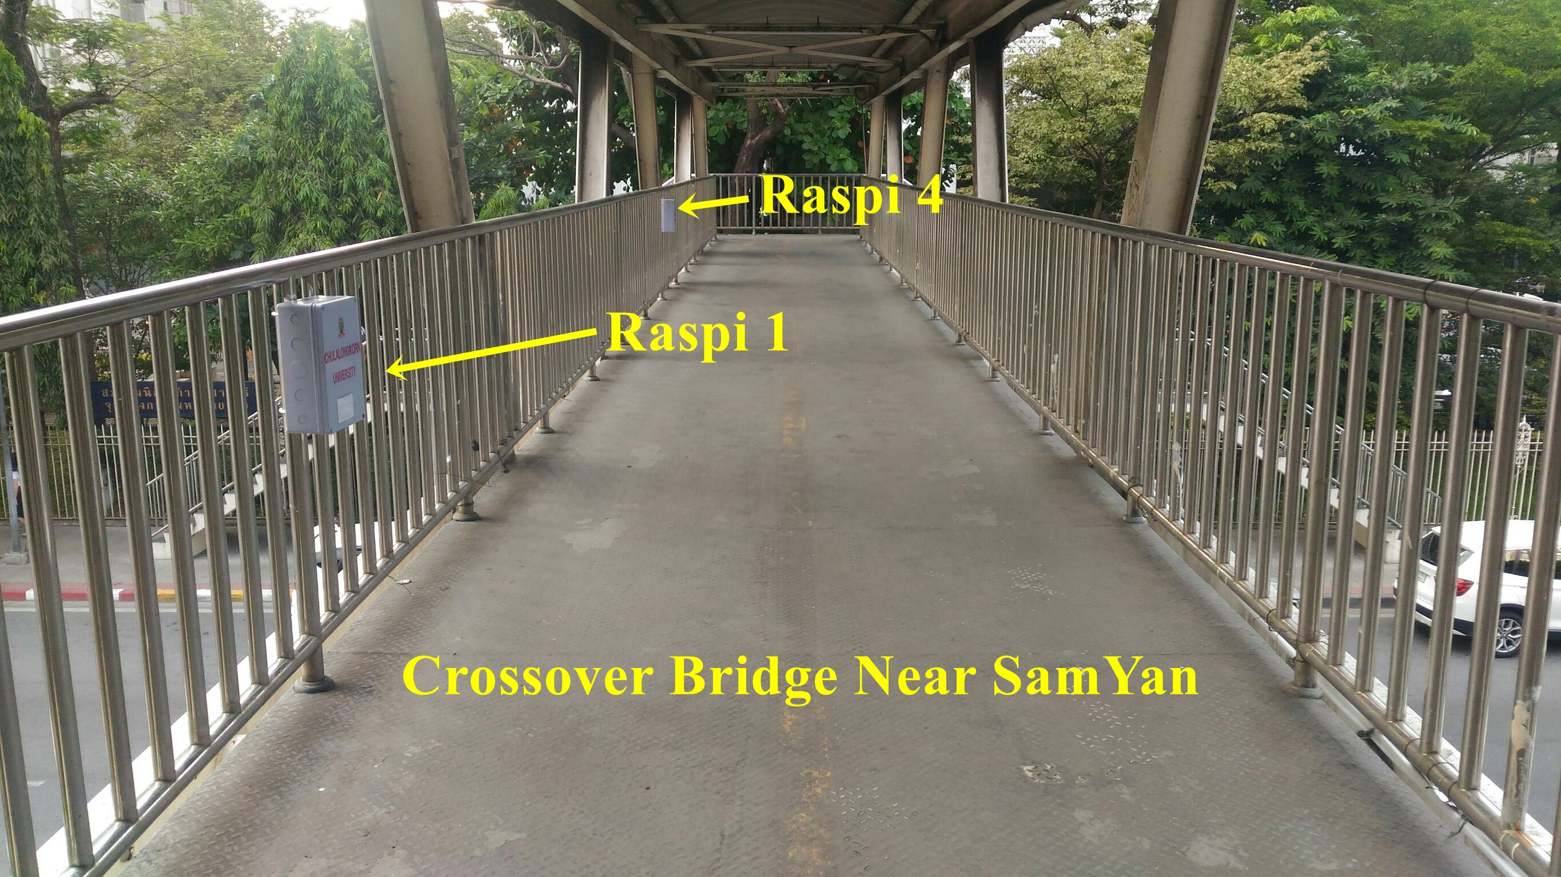
Crossover bridge on Phaya Thai Road
Position of wireless mesh node over crossover bridge on Phaya Thai Road

Slide 18
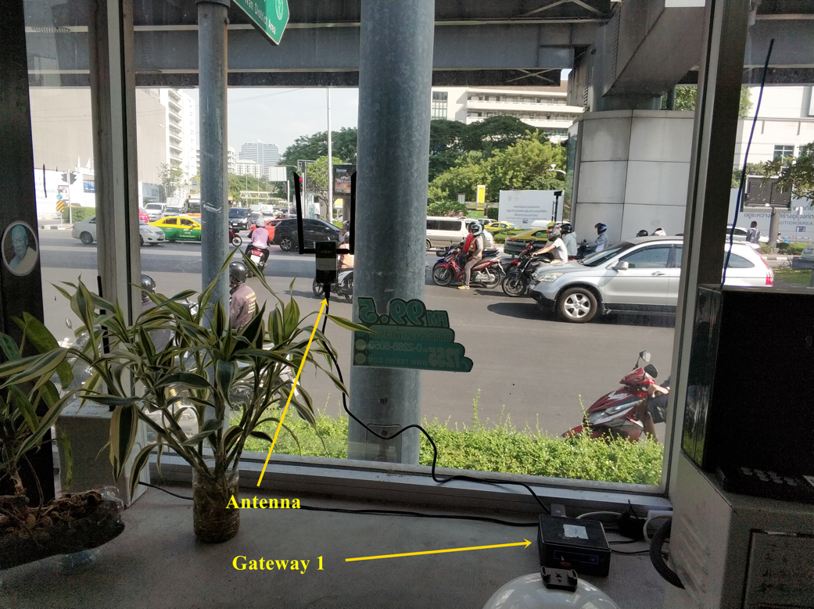
Traffic police box near SamYan MRT station on Rama 4 road where Gateway 1 is installed.

Slide 19
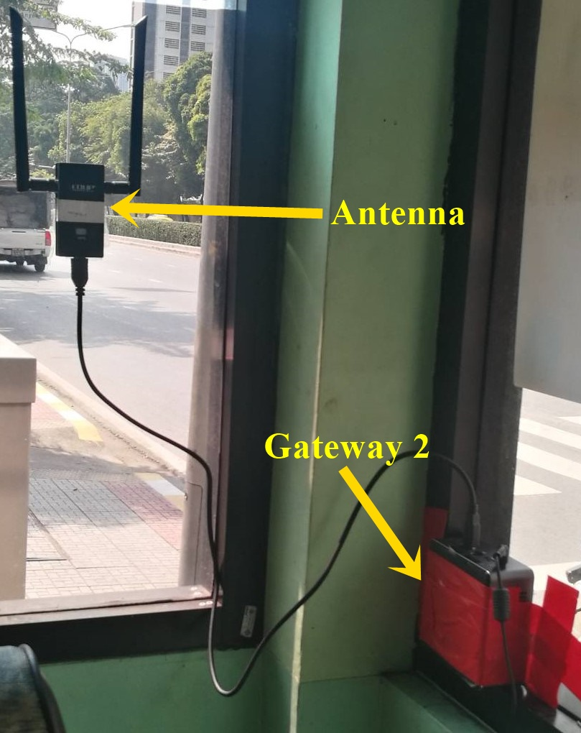
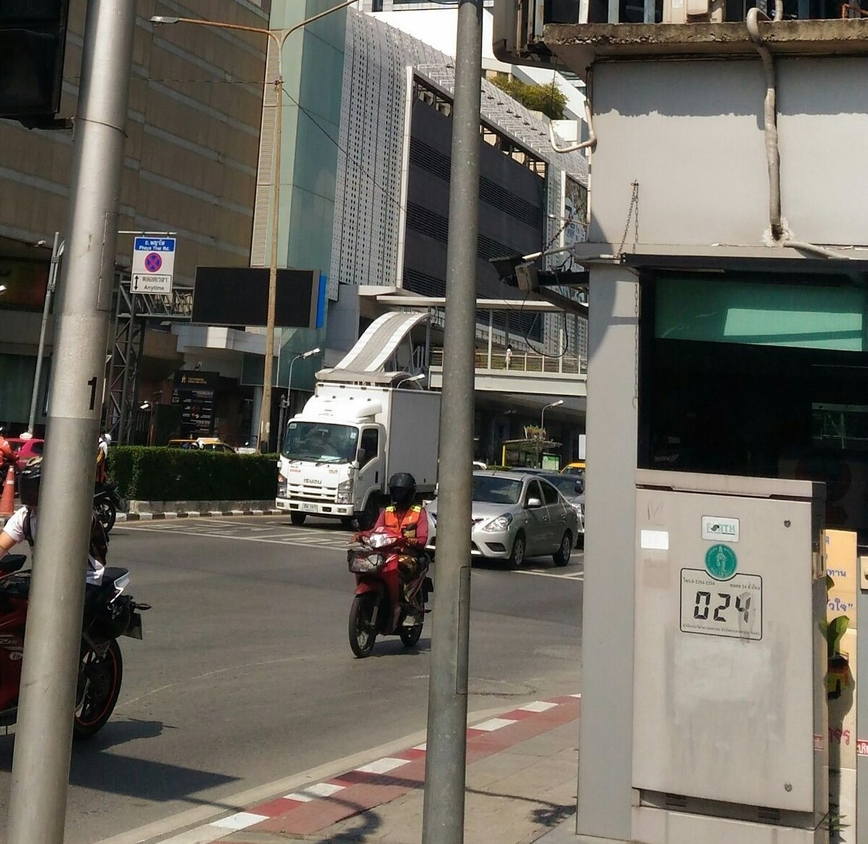
Traffic police box near Chulalongkorn Soi 12 where Gateway 2 is installed.
Traffic police box near Chulalongkorn Soi 12 where Gateway 2 is installed

Slide 20
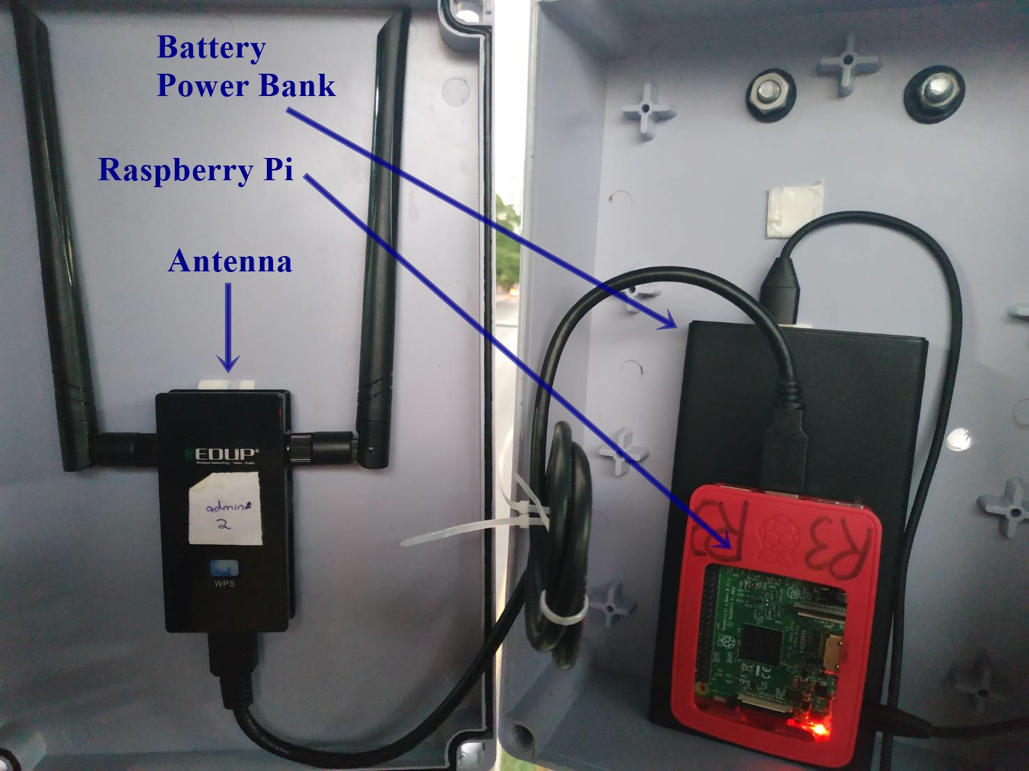
Installation of wireless mesh node inside waterproof box over crossover bridge on Phaya Thai Road

Slide 21
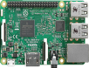



Illustration of Routing on Primary Route for Control Plane in Proposed Outdoor Small-scale SDWMN Testbed
Control network
Wireless ad-hoc link
Raspi 4
Raspi 5
Raspi 6
Gateway 1
Gateway 2
RYU
Raspi 1
Raspi 2
Raspi 3

Slide 22
Illustration of Routing on Primary Route for Data Plane in Proposed Outdoor Small-scale SDWMN Testbed
Wireless ad-hoc link
Data network
Group 1
Group 2
Raspi 4
Raspi 5
Raspi 6
Gateway 1
Gateway 2
RYU
Raspi 1
Raspi 2
Raspi 3

Slide 23
Implementation of In-band Control Plane and Data Plane in Outdoor Medium-Range SDWMN Testbed
In-band control plane and data plane is established by installing predefined forwarding rules to the OVS of each wireless mesh node and each gateway.
Predefined forwarding rules are installed as a script that will be executed every time that the wireless mesh node is restarted.
Pre-defined forwarding rules establish the primary route for control plane and data plane in outdoor small-scale SDWMN testbed.

Slide 24
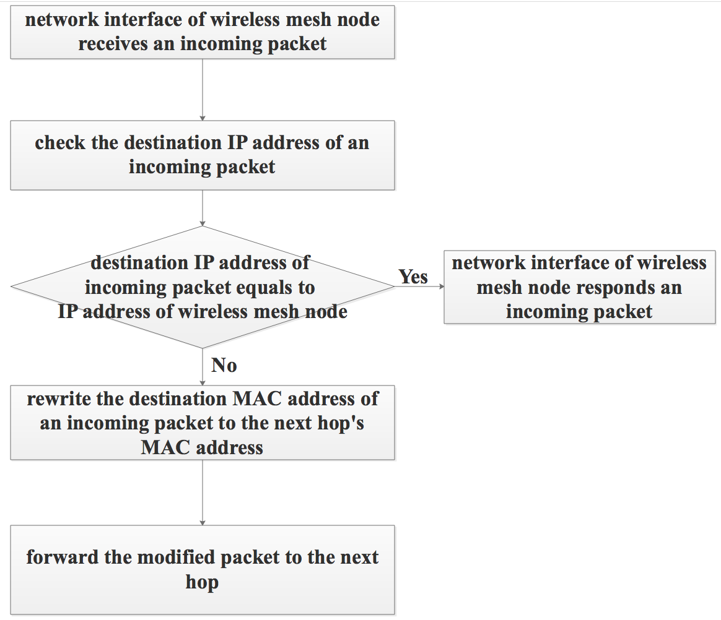
Forwarding Procedure of Wireless Mesh Node

Slide 25
OpenFlow-Based 2-hop Routing Scenario
We implement OpenFlow based 2-hop simplified routing by rewriting the header of destination MAC address with one gateway and two wireless mesh nodes.

Slide 26
Detection of Liveness of Every Active/Inactive Wireless Mesh Node by Ryu Controller
RYU Controller
Wireless Mesh Node
OpenFlow Echo Request
OpenFlow Echo Reply
OpenFlow Echo Request
OpenFlow Echo Reply

Slide 27
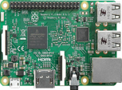
Detection of Failure/Unreachable of Every Wireless Mesh Node by Ryu Controller
Wireless mesh node is down
RYU Controller
Wireless Mesh Node
1st OpenFlow Echo Request
2nd OpenFlow Echo Request
3rd OpenFlow Echo Request
4th OpenFlow Echo Request
maximum_unreplied_echo_requests = 4
Echo_request interval = 3
Socket_Timeout = 5

Slide 28

Rerouting Scenario for Control and Data plane
Control Plane
Data Plane
Raspi 1’s Unreachable
4
5
6
4
5
6
8
9
8
9
1
2
3
2
3
RYU
RYU
Raspi 2’s Unreachable
4
5
6
4
5
6
8
9
8
9
1
2
3
1
3
RYU

Slide 29
Control Plane
Data Plane
Raspi 3’s Unreachable
4
5
6
4
5
6
8
9
8
9
1
2
3
1
2
RYU
RYU
Raspi 4’s Unreachable
4
5
6
5
6
8
9
8
9
1
2
3
1
2
3
RYU
RYU

Slide 30
Control Plane
Data Plane
Raspi 5’s Unreachable
4
5
4
6
6
9
8
9
8
1
1
2
3
2
3
RYU
RYU
Raspi 6’s Unreachable
4
5
6
4
5
8
9
8
9
1
2
3
1
2
3
RYU
RYU

Slide 31
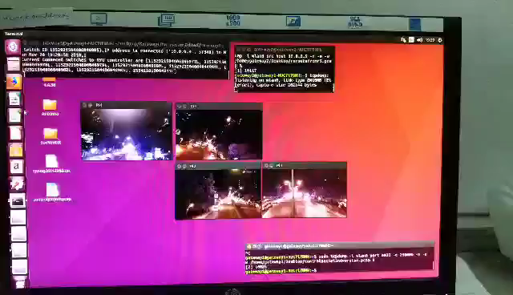
Practical Deployment Trial for Integrated SDWMN and Traffic Monitoring Application on Phaya Thai Road

Slide 32
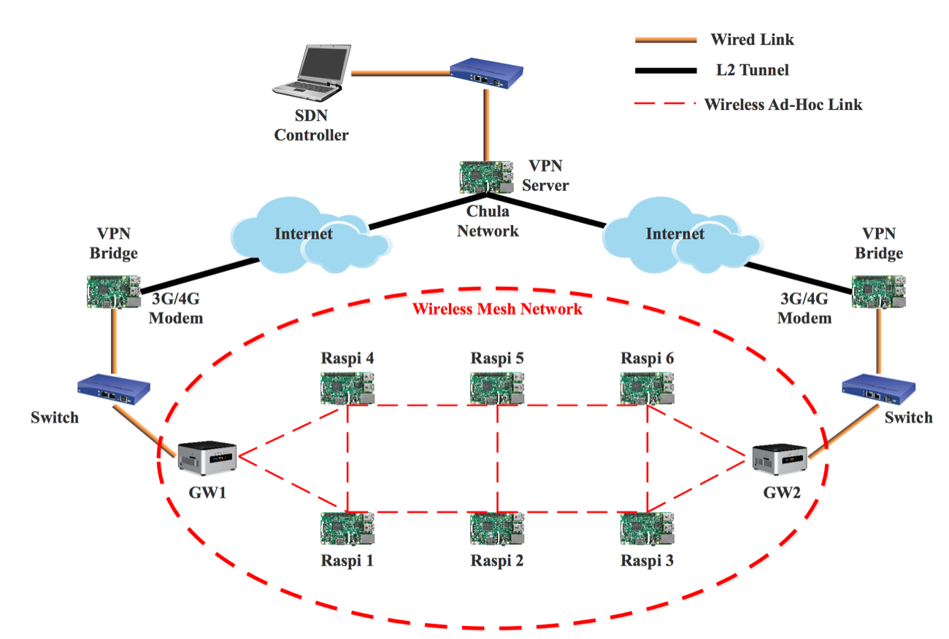
Design of updated SDWMN with Virtual Private Network
Control Route
Private Network

